Slide 1
The State of the World’s Oceans
Prospects for renewal of the deep waters
Jim Galasyn
MS Green
14 September 2007
original content © 2007 James Galasyn

Slide 2
Health of the Oceans
Background
Ocean stressors
Why the oceans matter
How to preserve the oceans

Slide 3
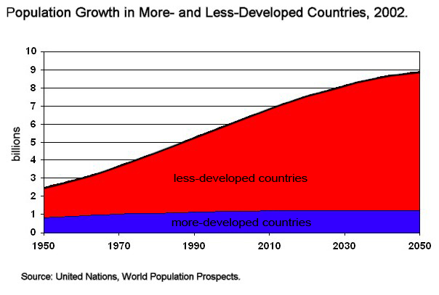
Human Population
Population

Slide 4
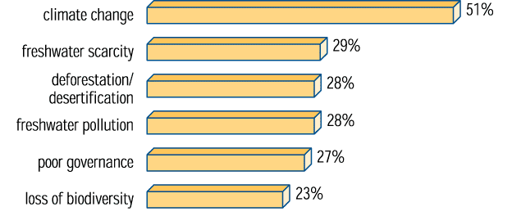
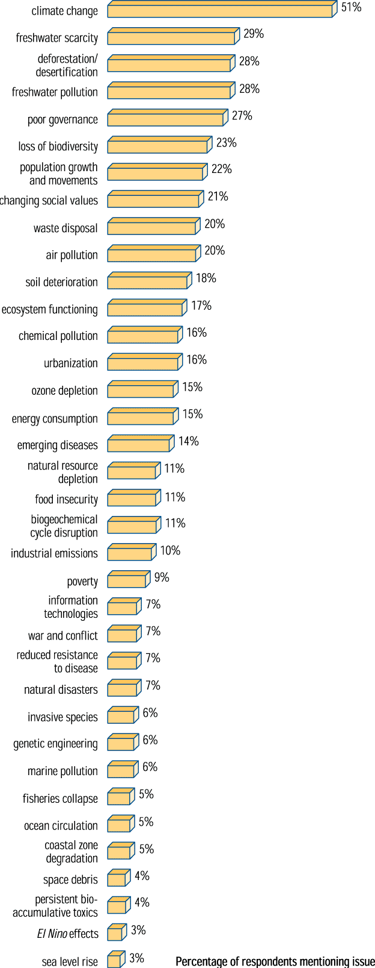
Our Biggest Problems
…
SCOPE survey: Issues for the 21st century

Slide 5
Ocean Stressors
Acidification
Coral reef bleaching
Dead zones (Eutrophication)
Biomass loss

Slide 6
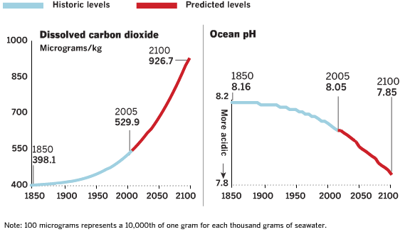
Ocean Acidification
Ocean chemistry is changing 100 times faster than in the last 650,000 years.
Altered Oceans

Slide 7
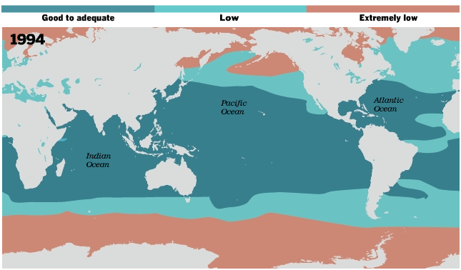
Ocean Acidification
Ocean acidity and favorability to coral, measured (A Chemical Imbalance).

Slide 8
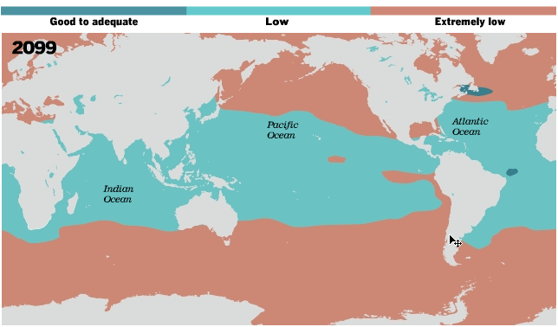
Ocean Acidification
Ocean acidity and favorability to coral, predicted (A Chemical Imbalance).

Slide 9
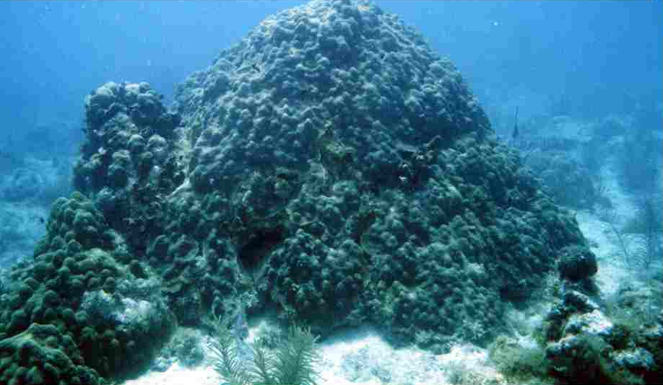
Coral Reef Bleaching
Montastrea annularis at Sand Key, 6/3/96

Slide 10
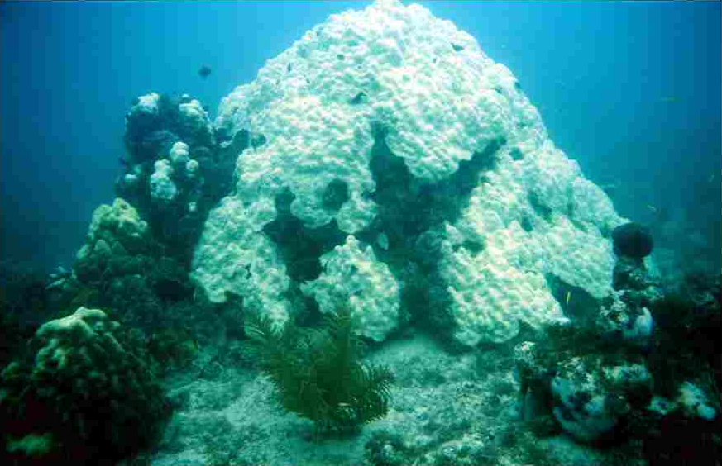
Coral Reef Bleaching
Montastrea annularis bleaching at Sand Key, 10/02/97

Slide 11
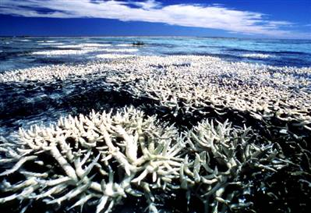
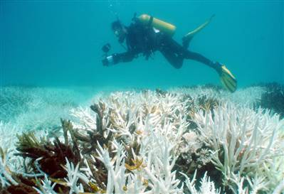
The White Desert
Bleached coral on Australia's Great Barrier Reef in 1998 . Large scale coral die-offs are now occurring more frequently than at any time in the last 11, 000 years (Most coral reefs under threat, some resilient; Coral stress like never in history).
New bleaching around the Keppel Islands of Australia's Great Barrier Reef include this stand of staghorn corals, photographed on Feb. 22, 2006. Photo by Damian Thomson / Australian Institute of Marine Science (Part of Great Barrier Reef now ‘a white desert’).

Slide 12
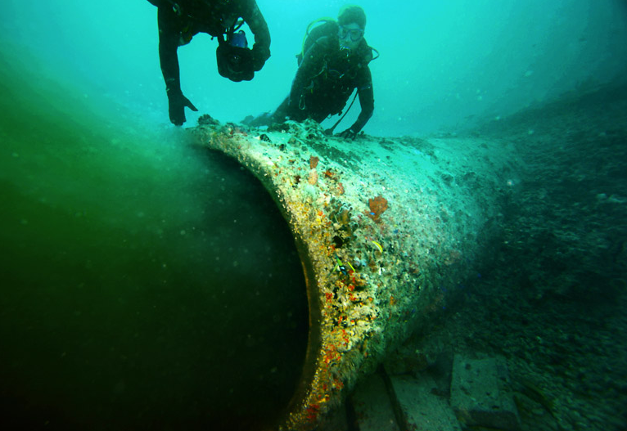
Dead Zones
Partially treated sewage from Hollywood, Florida. Photo by Rick Loomis (Altered Oceans).

Slide 13
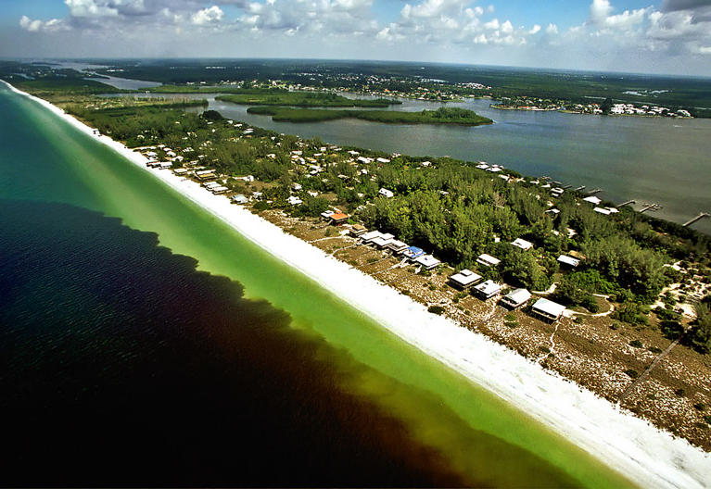
Dead Zones
A dark red bloom of Karenia Brevis algae at Little Gasparilla Island, Florida. Photo by Paul Schmidt (Altered Oceans).

Slide 14
Dead Zones
Diseased brain coral in the Florida Keys. Photo by Rick Loomis. (Altered Oceans)

Slide 15
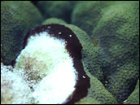
Dead Zones
Black band disease attacks coral that have been weakened by sedimentation, excess nutrients, toxic chemicals, and warmer than normal temperatures. Photograph by Phillip Dustan (Mapping the decline of coral reefs).

Slide 16
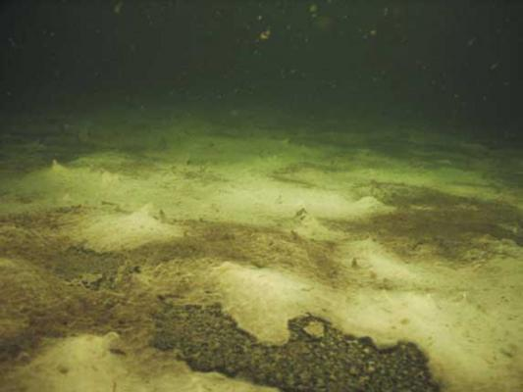
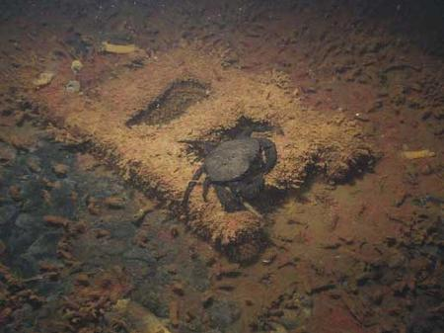
Dead Zones
Bacterial and algae mats in Hood Canal, 2006. Photos by Shane Miller. (Mysterious blob may be killing marine life)

Slide 17
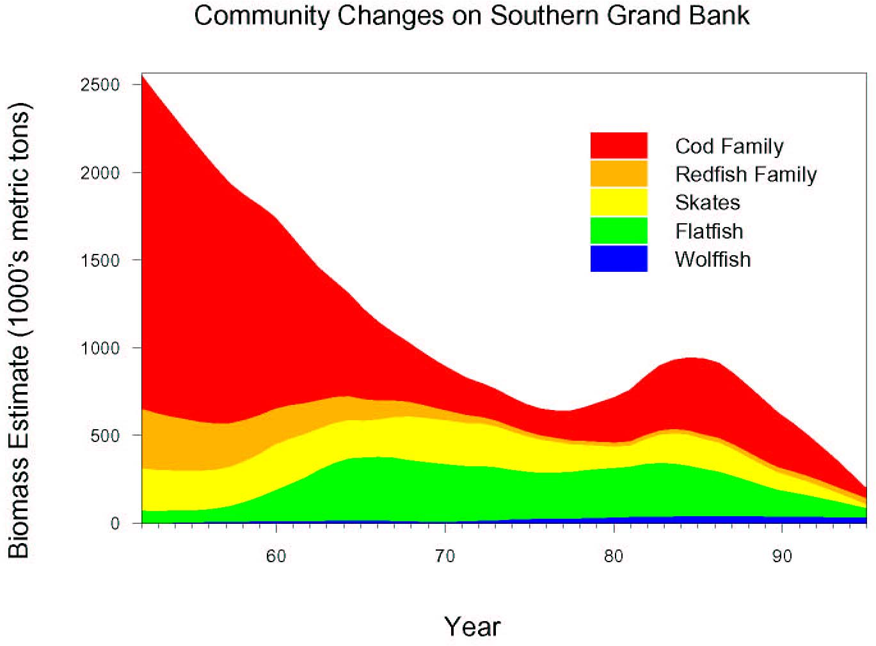
Loss of Ocean Biomass
Community Changes on the Southern Grand Bank, Altered Oceans

Slide 18
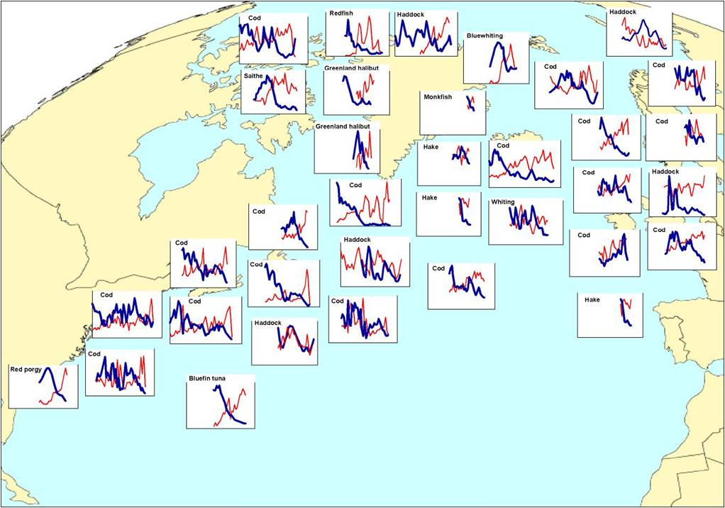
Loss of Ocean Biomass
A new look at the interactions between marine mammals and fisheries (or did we we mess up the North Atlantic, and now blame them for what we did?)

Slide 19
Overexploitation
90% of tuna, cod, and other big fish have disappeared in the last 50 years.
97% of Florida’s elkhorn and staghorn coral have disappeared since 1975.
650 gray whales have washed up sick or dead on the West Coast in the last 7 years.
$150b in subsidies to catch $100b of fish
Altered Oceans, James Martin 21st Century School

Slide 20
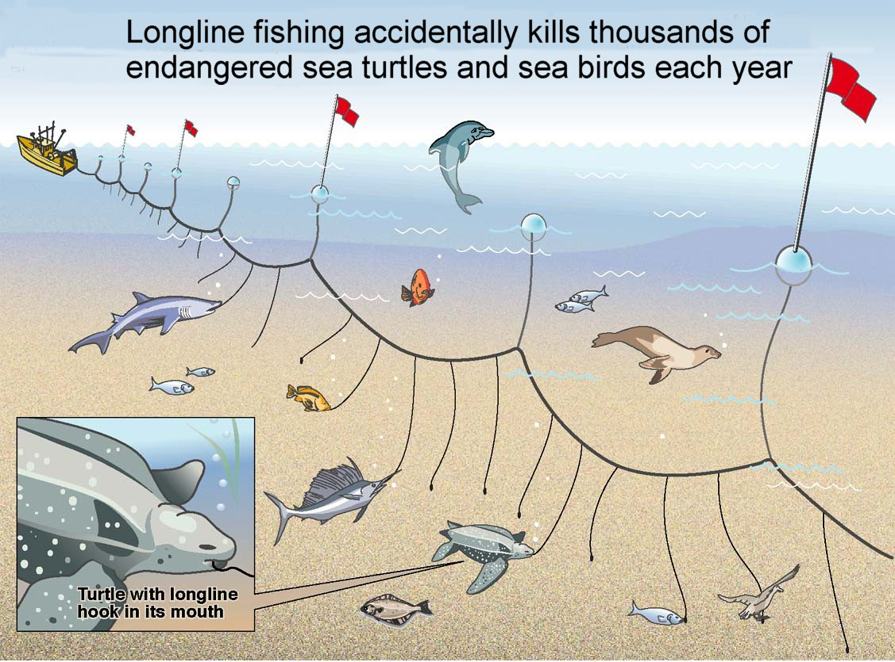
Overexploitation

Slide 21
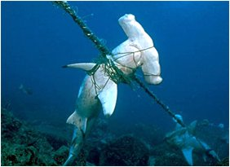
Overexploitation
Dead sharks caught in longline. Photo by Sea Shepherd Conservation Society.

Slide 22
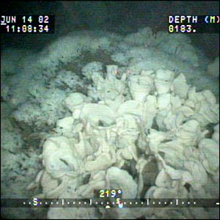
Overexploitation
Hexactinellid sponges found only on deep-water reefs off the western coast of Canada. (Ban on ‘brutal’ fishing blocked).

Slide 23
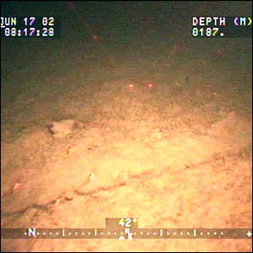
Overexploitation
The same area after bottom trawling, three days later. (Ban on ‘brutal’ fishing blocked).

Slide 24
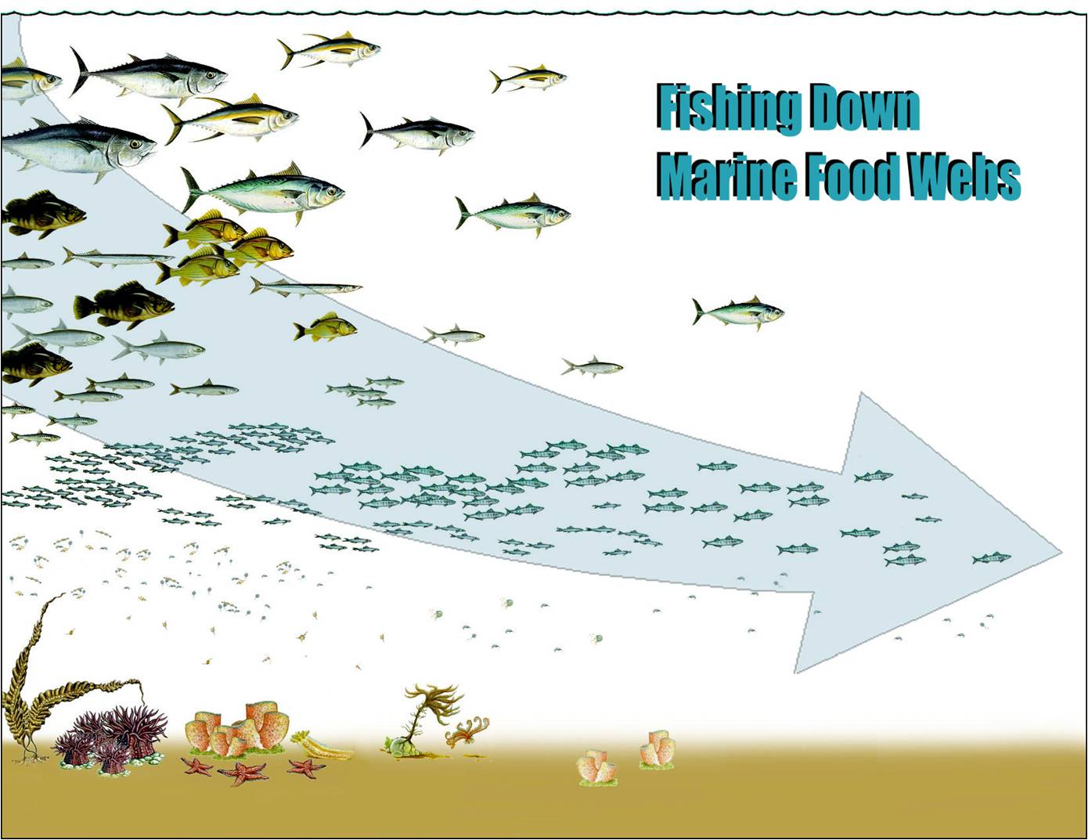
Overexploitation

Slide 25
Overexploitation
The Status of World Fisheries

Slide 26
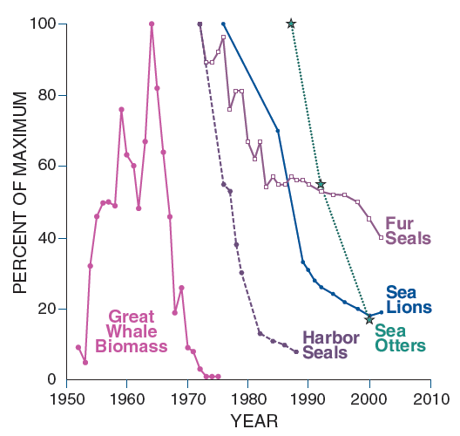
Unforeseen Consequences
Whaling and the destruction of the North Pacific kelp forests
Sequential collapse of marine mammals in the North Pacific Ocean and southern Bering Sea

Slide 27
Unforeseen Consequences
Shark fishing and the destruction of the N. Carolina scallop industry
Abundance of great sharks near N. Carolina. (Cascading effects of the loss of apex predatory sharks from a coastal ocean)

Slide 28
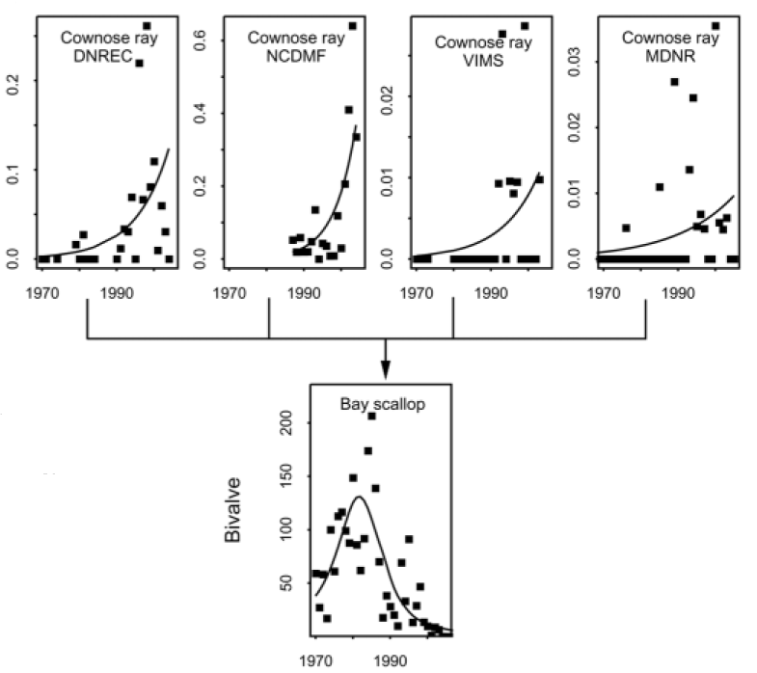
Unforeseen Consequences
Shark fishing and the destruction of the N. Carolina scallop industry
Abundance of rays and scallops. (Cascading effects of the loss of apex predatory sharks from a coastal ocean)

Slide 29
Unforeseen Consequences
Census of Marine Life: History of Marine Animal Populations Project

Slide 30
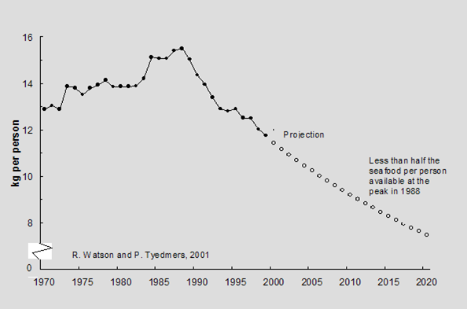
Unforeseen Consequences
The Status of World Fisheries

Slide 31
What Might Happen?
Geological evidence
Climate change disruptions
Greenland ice sheet collapse
Ocean-wide anoxia
The sixth great extinction

Slide 32
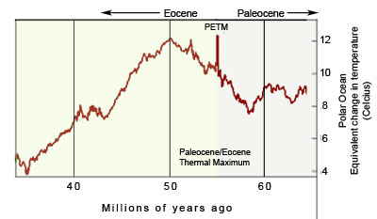
Paleocene-Eocene Thermal Maximum
55 million years ago
Lasted 50,000 to 100,000 years
CO₂ concentration doubled or tripled to 1,000 ppm
10-12 F rise in temperature
Most severe marine extinction in the last 90 million years
Humans will add as much carbon to the atmosphere in 500 years (1800 to 2300) as the PETM did over 10,000 years
Climatic rerun, only faster this time, Impact from the Deep, Scientists link volcanic eruptions that formed North Atlantic Ocean to ancient global warming

Slide 33
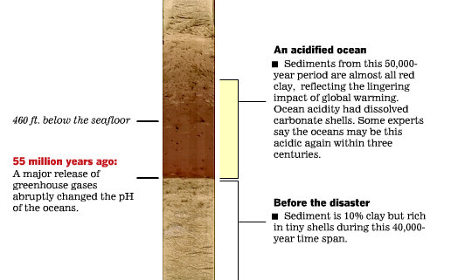
Paleocene-Eocene Thermal Maximum
Altered Oceans

Slide 34
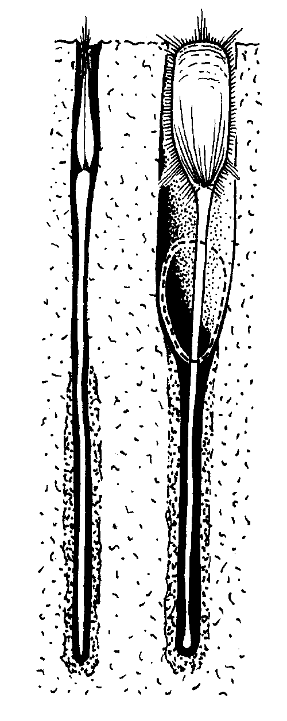
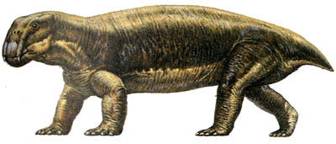
Permian-Triassic Extinction
251 million years ago
CO₂ just above 1,000 ppm
90% of ocean dwellers extinct
70% of plants, animals, insects on land
Largest disaster life on Earth has faced
Lystrosaurus
Lingula
Extinction, Impact from the Deep

Slide 35
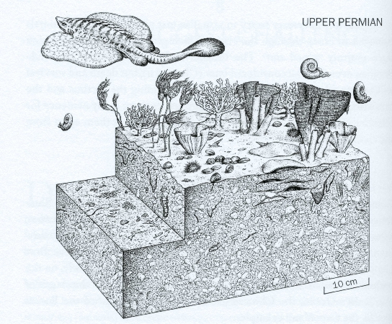
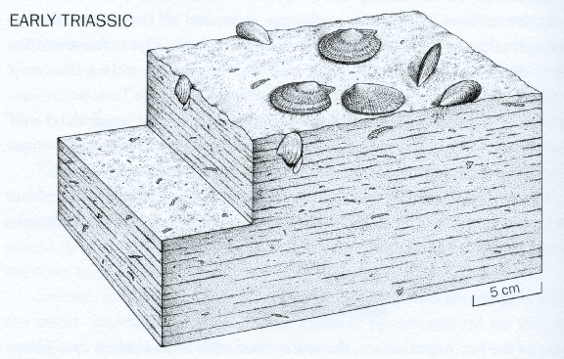
Permian-Triassic Extinction
Seabeds near China, before and after the extinction event (Extinction).

Slide 36
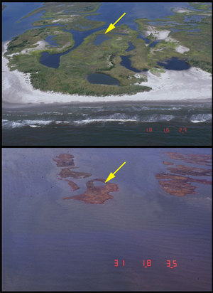
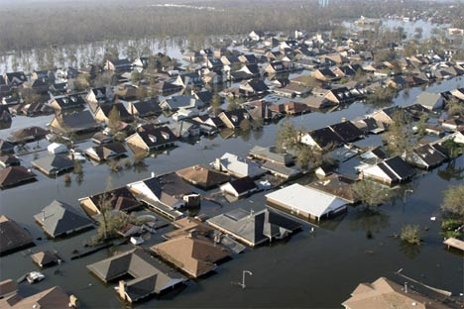
Climate Change Disruptions
New Orleans after Katrina.
Chandeleur Islands, before and after Katrina.
Shoreline erosion rates along barrier islands of the north central gulf of Mexico, Before and After Photo Comparisons: Chandeleur Islands

Slide 37
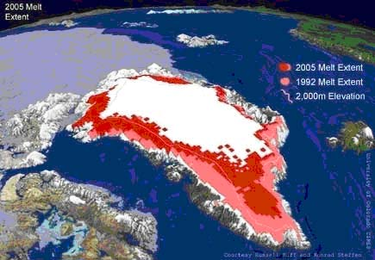
Greenland Ice Sheet Collapse
Losing 41 cubic miles/year.
3x faster than early estimates.
Sudden increase in 2004.
Sea level would rise 20 feet.
Issues in Risk Science 5: Dangerous Climate Change, Ice sheet melting faster than ever, Greenland Ice Sheet on a Downward Slide

Slide 38
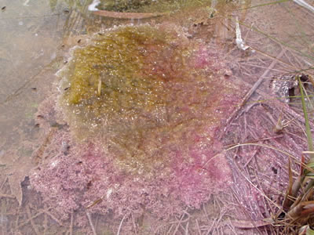
Ocean-wide Anoxia
Green cyanobacteria grow over purple sulfurs in saltmarsh panne by Chapman's Landing in Stratham, NH (Kingdom Monera).
Impact from the Deep, Mass Extinction's Cause: 'Sick Earth‘

Slide 39
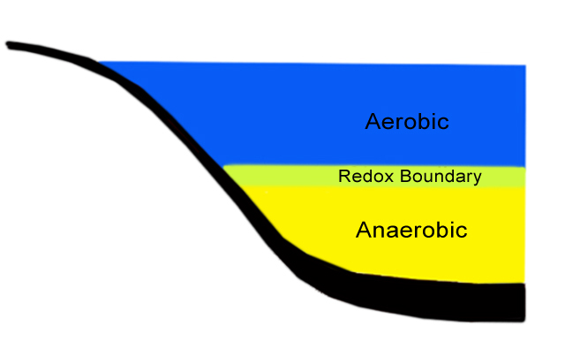
Ocean-wide Anoxia
The ocean chemocline.
.

Slide 40
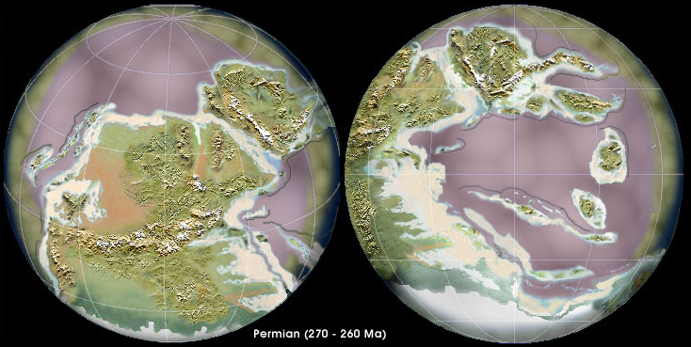
Ocean-wide Anoxia
Impact from the Deep, Mass Extinction's Cause: 'Sick Earth‘, The Late Paleozoic

Slide 41
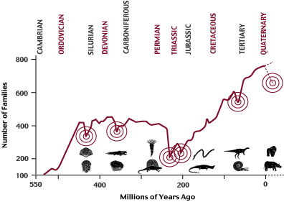
The Five Great Extinctions
Mass extinction graph

Slide 42
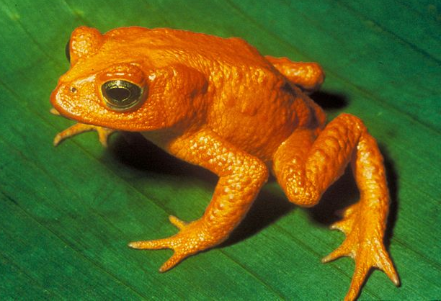
The Sixth Great Extinction
100 - 1000 times higher than background rate
Half of bird and mammal species extinct in 200 to 300 years
5,000 to 25,000 species per year (Benton)
50,000 to 100,000 species per year (Leakey)
Golden toad, Bufo periglenes, extinct c. 1989 (Golden Toad).
Extinction

Slide 43
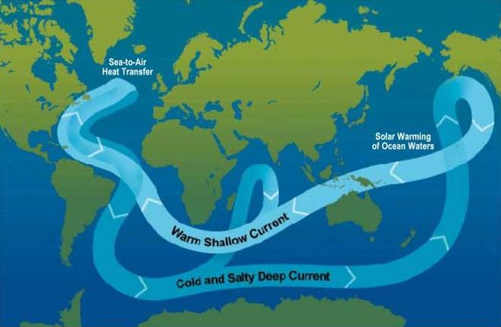
Why Biodiversity Matters
Marine Life Stirs Ocean Enough To Affect Climate, Mass Extinction's Cause: 'Sick Earth‘, Termohaline Circulation

Slide 44
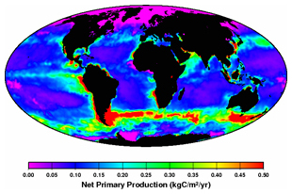
Why Biodiversity Matters
Deepwater upwelling driven by animal muscle energy.
Biosphere invests 1 terawatt of energy in marine animal muscle motion.
Loss of ocean biomass has grave implications for ocean convection.
Ocean convection controls global climate.
Permian-Triassic extinction followed failure of thermohaline convection.

Slide 45
How to preserve the oceans
Restrict destructive fishing practices
Enforce conservation law at sea
Stop sewage and chemical discharges
Reconstruct coral reefs
Develop alternative energy sources
Sequester carbon
Transition to organic farming
Build green architecture

Slide 46
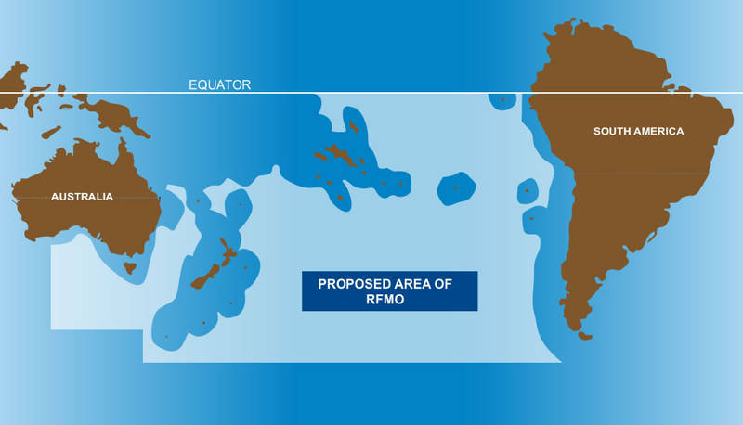
Restricting destructive fishing practices
Bottom trawling exclusion zone (South Pacific Regional Fisheries Management Organization).

Slide 47
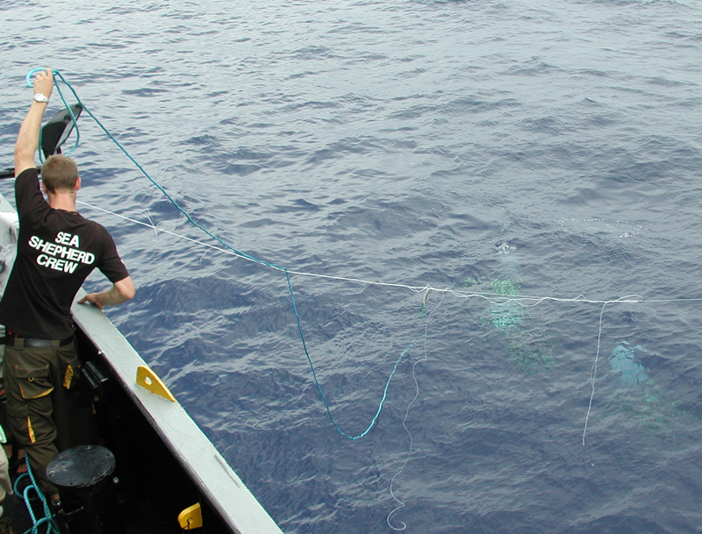
Enforcing conservation law at sea
Sea Shepherd crew disposing of pirate longline. Photo by Isobel Alexander.

Slide 48
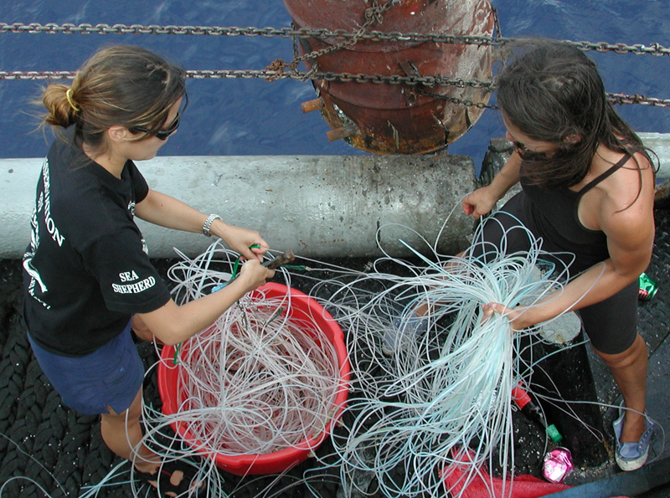
Enforcing conservation law at sea
Sea Shepherd crew disposing of pirate longline. Photo by Isobel Alexander.

Slide 49
Sewage and chemical discharges
Secondary treatment: $38 b/yr, $490b total
Tertiary treatment: $67 b/yr $870 b total
Cost estimates for different levels of sanitation services (Financing wastewater collection and treatment in relation to the Millenium Development Goals).

Slide 50
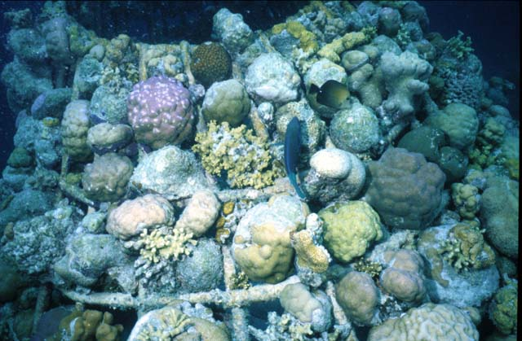
Coral Reef Reconstruction
Maldive Barnacle Biorock reef structure

Slide 51
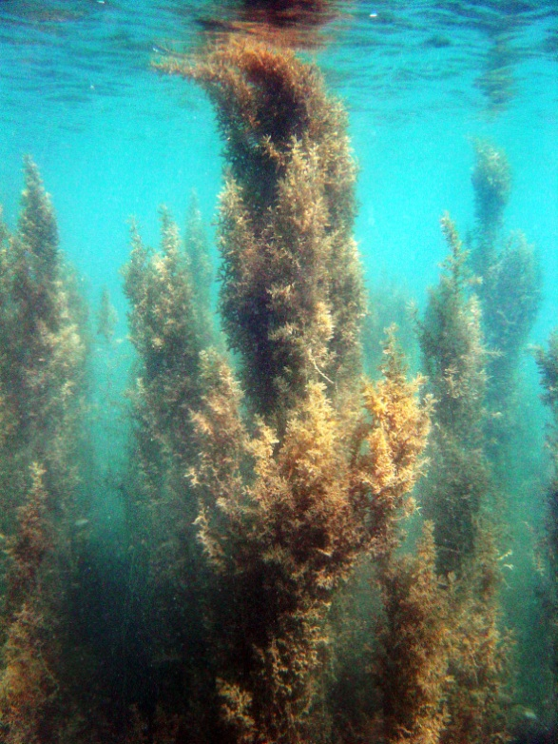
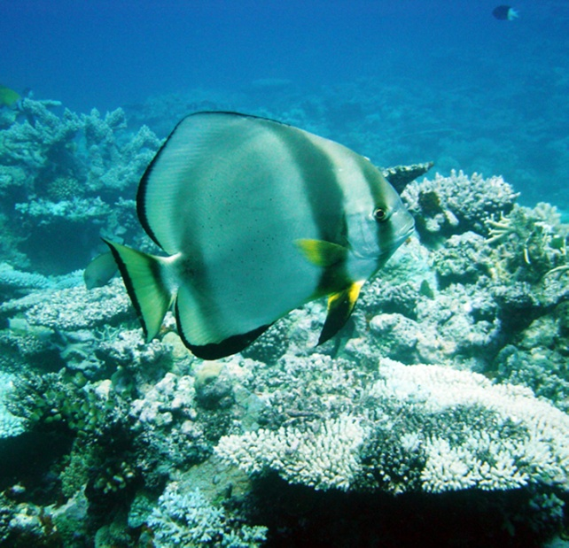
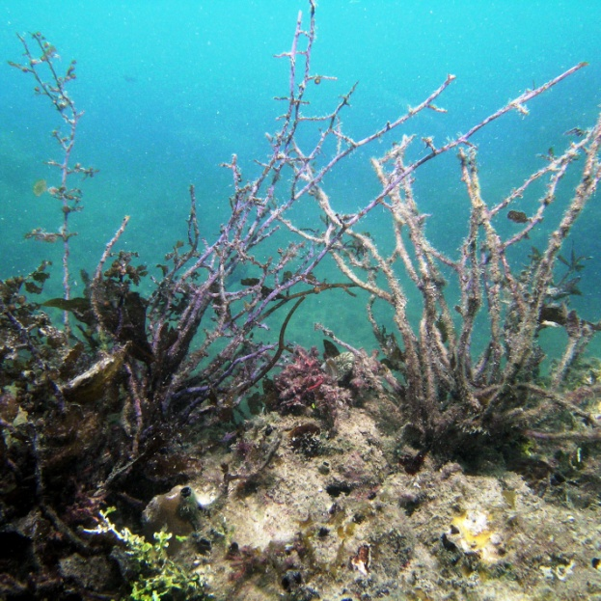
Coral Reef Reconstruction
Batfish (platax pinnatus) clears algae from coral (Batfish to the rescue).

Slide 52
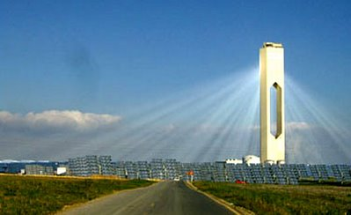
Solar Thermal
11 MW solar tower in Seville, Spain (Enviromission).

Slide 53
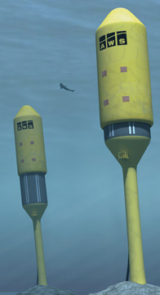
Ocean Energy
Ocean Current Turbines
Archimedes Wave Swing

Slide 54
Carbon Sequestration
CO₂ is buried in a saline aquifer beneath the Sleipner West natural gas field in the North Sea. Photo courtesy of Statoil (Demonstrating Carbon Sequestration).

Slide 55
Carbon Sequestration
EU GeoCapacity
CO2 Capture Project

Slide 56
Organic Farming
Organic farming combats global warming

Slide 57
What You Can Do Right Now
Don’t despair.
Don’t eat sushi; buy only sustainable seafood.
Don’t use pesticides, herbicides, or fertilizers.
Use phospate-free detergent.
Buy organic and locally grown food.
Recycle aggressively.
Prefer public transportation to driving.
Reduce or eliminate air travel.

Slide 58
Resources
Monterey Bay Aquarium’s Seafood Watch
10 Things You Can Do (http://www.seaweb.org/addyourvoice/10thingsyoucando.php)
Seaweb (http://www.seaweb.org/)
Marine photo bank (http://www.marinephotobank.org)
Seafood Choices Alliance (http://www.seafoodchoices.org)
The Current Mass Extinction (http://www.well.com/user/davidu/extinction.html)
Species Alliance (http://www.speciesalliance.org/)
BigSky Carbon Sequestration Partnership (http://www.bigskyco2.org/terrestrial.htm)
Sequential collapse of marine mammals in the North Pacific Ocean and southern Bering Sea
Issues in Risk Science 5: Dangerous Climate Change
Ocean and Climate Change Institute, Abrupt Climate Change
Greenland ice cap as climate archive
A lecture on land use, deforestation, and loss of grasslands and wetlands
NoFly Travel (http://www.noflytravel.com)

